Slide 1
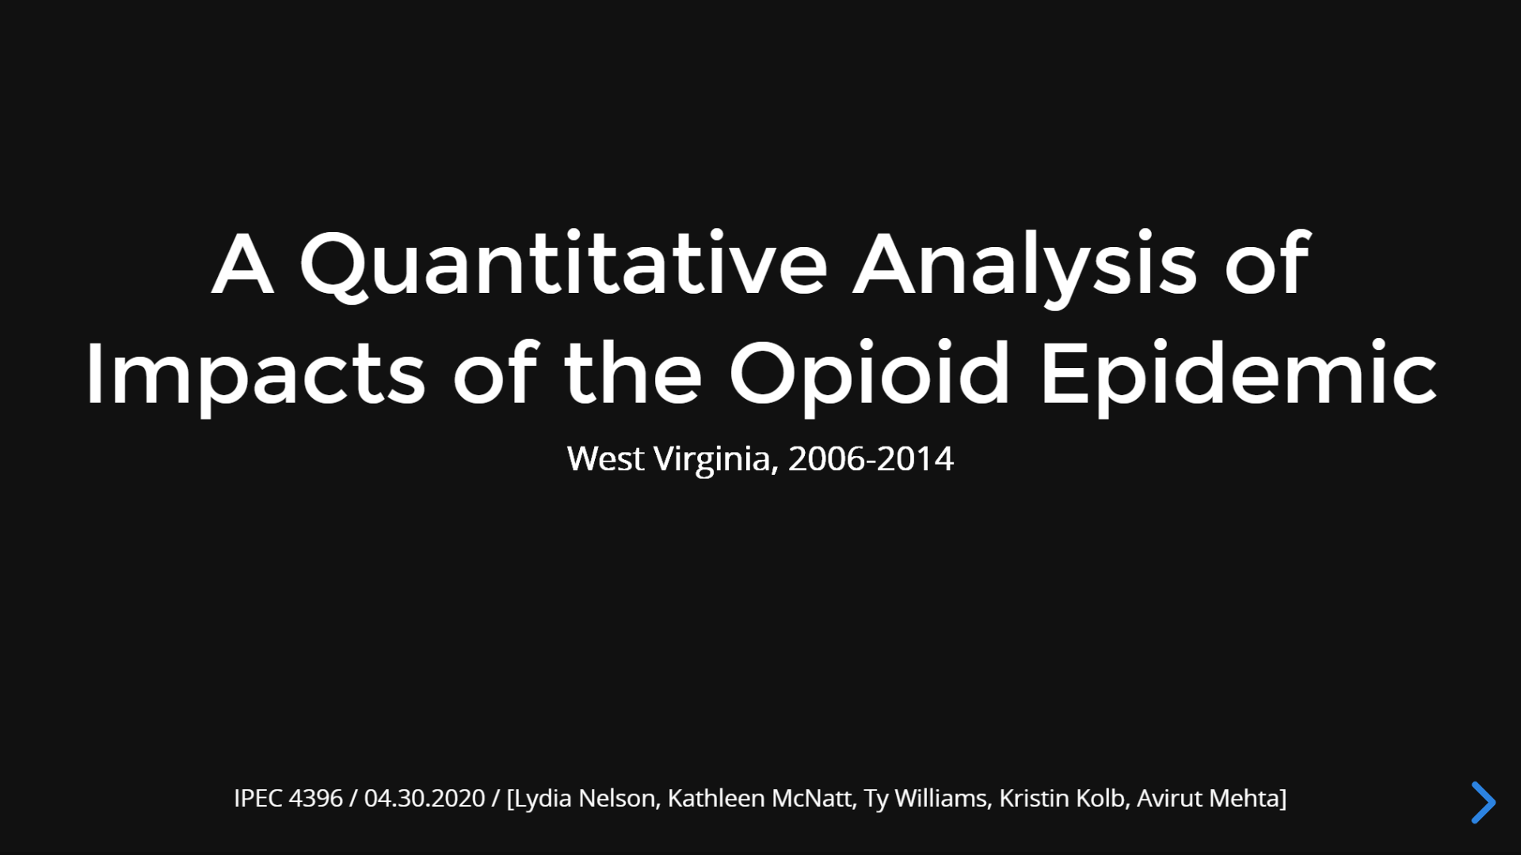
Notes:
Hi! Our group attempted to perform a statistical analysis with a geographic component on the impacts of the opioid epidemic in West Virginia between 2006 and 2014.

Slide 2

Notes:
In reviewing previous literature, we focused on concisely answering three questions: what do we already know, what previous conclusions conflict, and what remains to be learnt within this field?

Slide 3
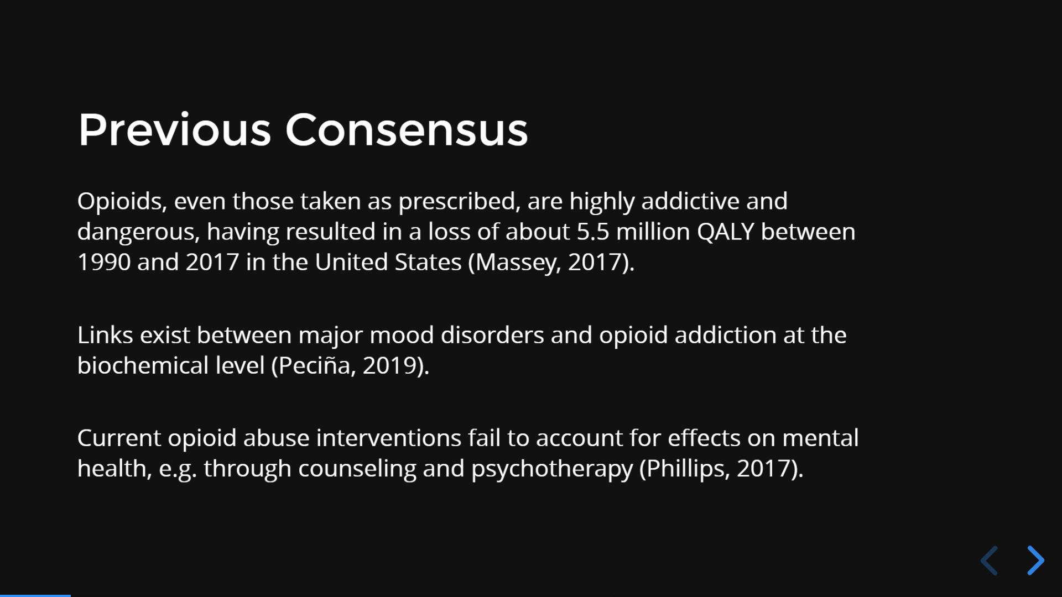
Notes:
The first study concluded that nonfatal opioid overdoses have risen over the years and that most of these overdose cases were not referred for substance use disorder treatment or harm reduction services, indicating the importance of further research into opioid addiction.
The second study concluded that PET scan baseline measures and increased understanding of neural circuitry have revealed that the binding of opioids to mu-opioid receptors in the brain, create antidepressant like effects. This linkage is apparent in the disproportionate use of opioids by patients with mood disorders who account for the majority of prescription opioid use in the United States. Emerging research continues to explain the mechanisms underlying dysregulation of the endogenous opioid system in depression and other major mood disorders.
The third study concluded that counseling and psychological therapies are not an expectation in treating patients with OUD (Opioid Use Disorder) and that The long-term maintenance of opioid agonists is associated with less prescription opioid use and better adherence to medication and psychological therapies for opioid dependence compared with opioid taper or psychological treatments alone. We therefore question how the untreated psychological impacts of OUD may create cyclical effects.

Slide 4
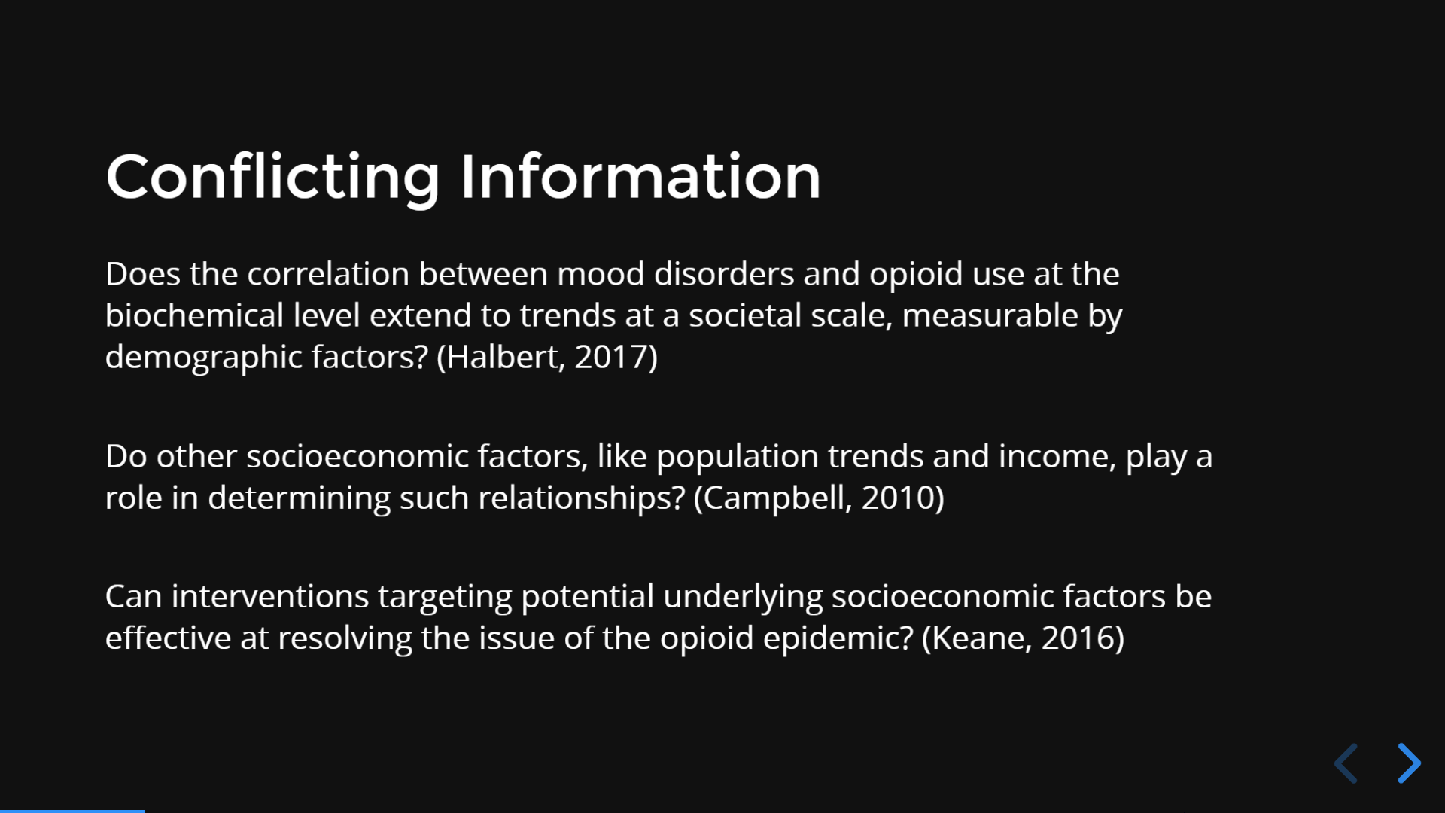
Notes:
Halbert concluded that the correlation between mood disorders and opioid use can be measurable based on demographic factors such as gender, race, and income level. However, there were no significant differences in age or education level reported.
However, Campbell socioeconomic factors like education level, age, and gender can have impacts on opioid abuse. He found the highest prevalence of long-term opioid use was among women and older persons, with 8% to 9% of older women maintaining long-term opioid use in 2005. These results concluded that socioeconomic factors can play a role in the relationship between opioid use and population trends.
We therefore believe there is conflicting information in the existing literature regarding the role that socioeconomic and demographic factors play in opioid use, particularly as it relates to mood disorder prevalence.
Keane concluded that early intervention services can be provided and useful in a variety of settings such as, school clinics, primary care offices, mental health clinics to people who have problematic use or mild substance use disorders. Early intervention consists of providing information about substance use risks, normal or safe levels of use, and strategies to quit or cut down on use and use-related risk behaviors and facilitating patient initiation and engagement in treatment when needed. We seek to reinforce this finding by supplementing information indicating that relationships exist between psychological trends and the opioid abuse disorder.

Slide 5
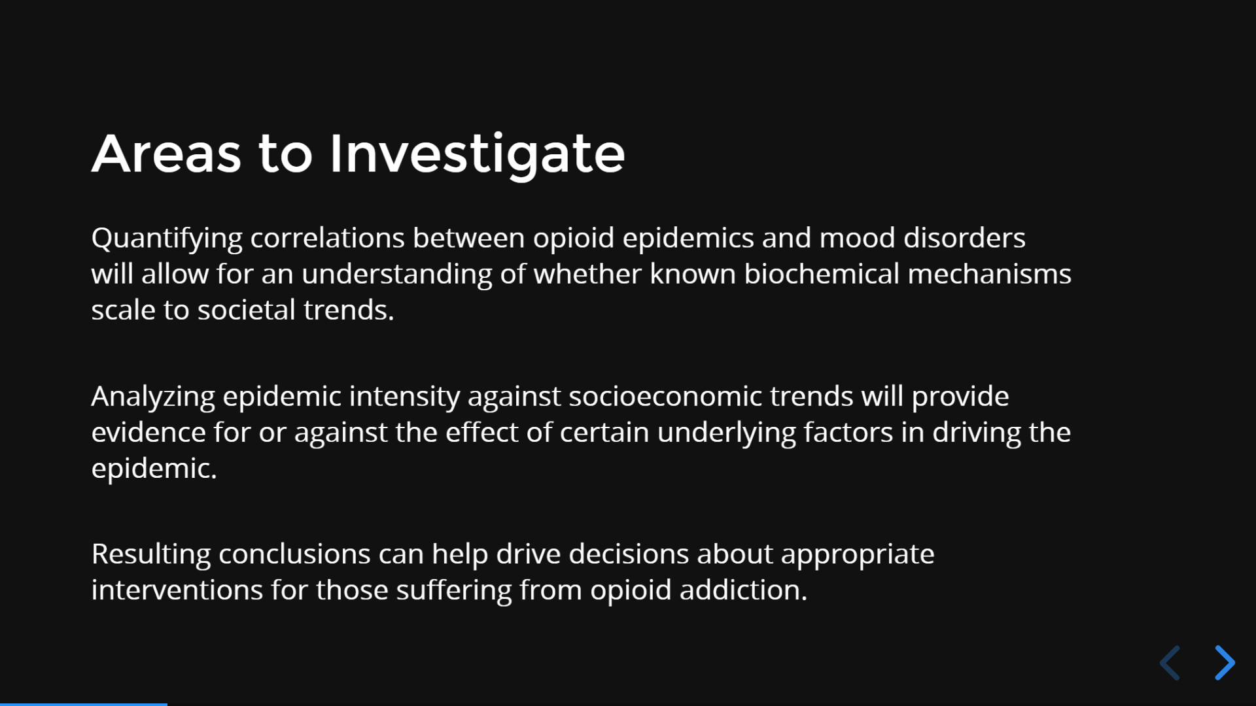
Notes:
By looking at the quantitative data correlations between opioid epidemics and mood disorders, such as depression or bipolar disorder, we are able to further understand how these biochemical interactions in people’s brains scale up against the overall trends in society.
With nearly all epidemics, socioeconomic trends such as a person’s income level or their education play a major role and can help to provide evidence for or against the various underlying factors that are possibly driving the epidemic even further. It is well known that certain groups of people are more targeted for certain viruses or diseases so it is important for our research to include these various factors.
We were hoping with the data we found we could, at the very least, have an idea on what are some sources of opioid addiction and ways they could possibly even be prevented. Ultimately, drawing on these conclusions would bring us to the main point of our investigations which was to help find solutions about the appropriate interventions for those who suffer from the opioid addiction that plagues people across the U.S and around the world.

Slide 6
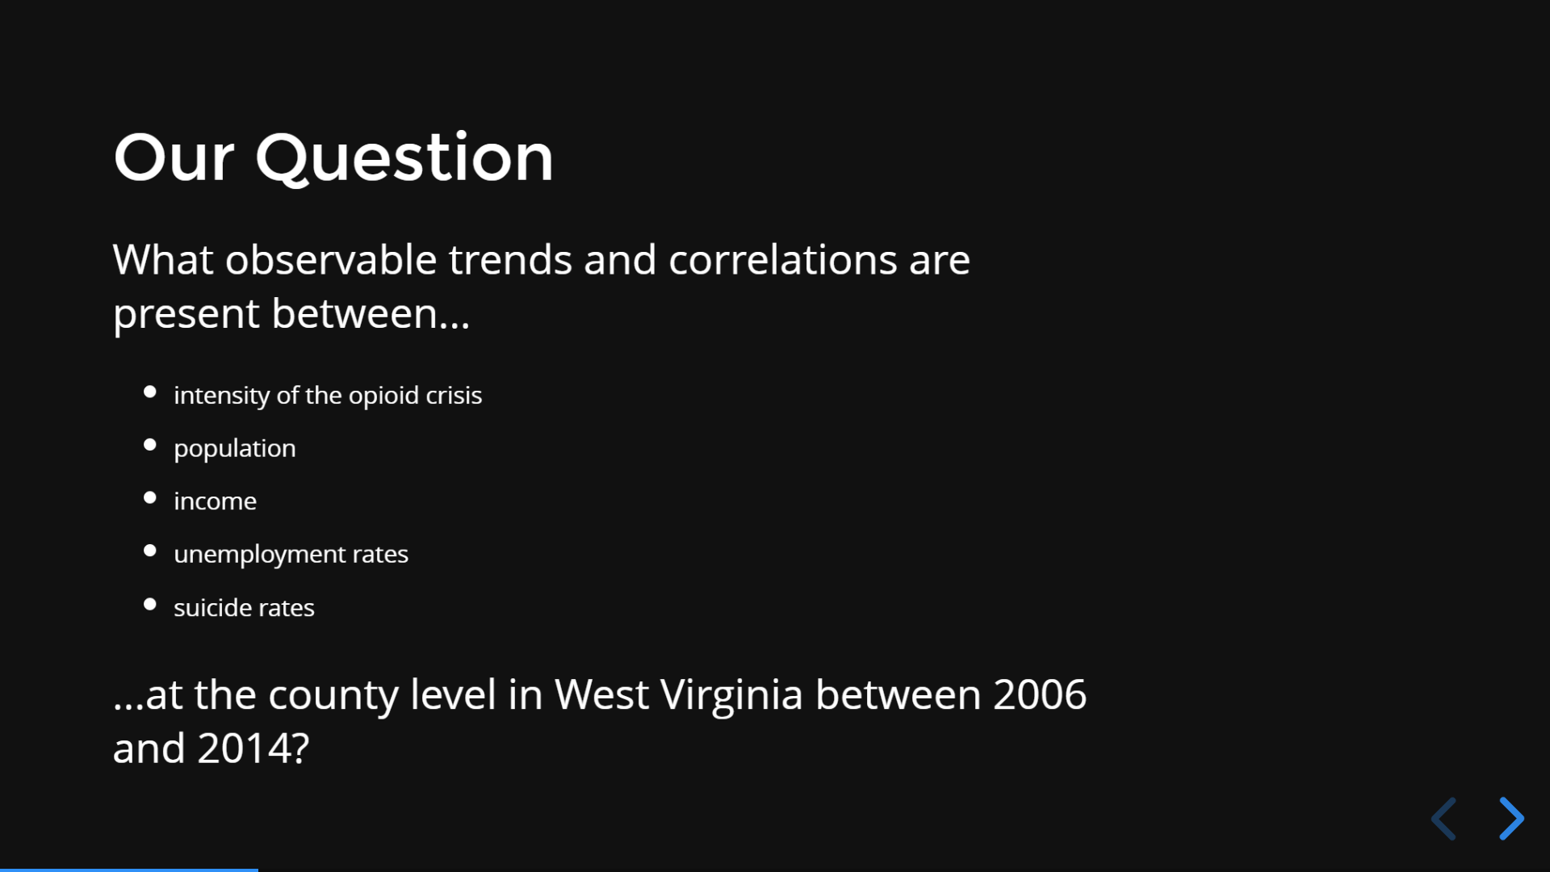
Notes:
Our research question for this presentation was to find out what observable trends and correlations are present between five various quantifiable data points at the county level in West Virginia. We are investigating the years between 2006 and 2014 and will be using the following variables: intensity of the opioid crisis, population, income, unemployment rates, and suicide rates.
Using these variables, we were hoping to find any kind of correlations or trends from the data to ideally help with finding possible solutions or preventions for opioid addiction, adding on data that has previously been found.

Slide 7

Notes:
Kat

Slide 8
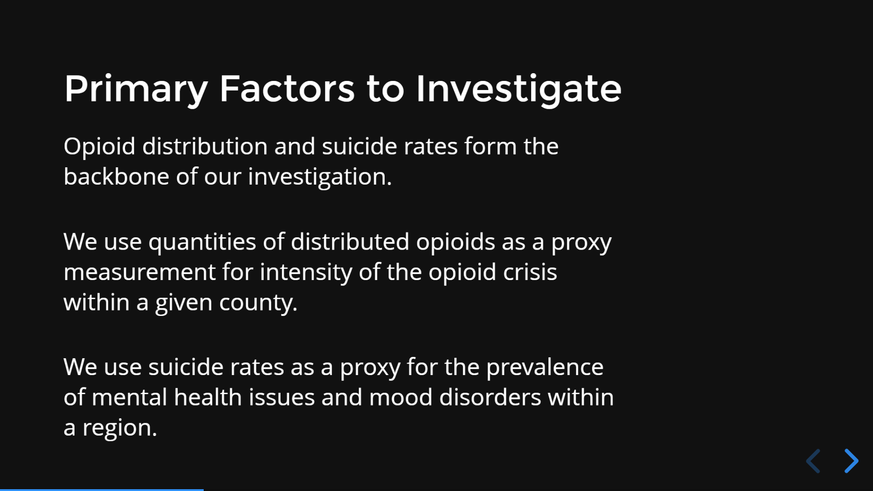
Notes:
Kat

Slide 9
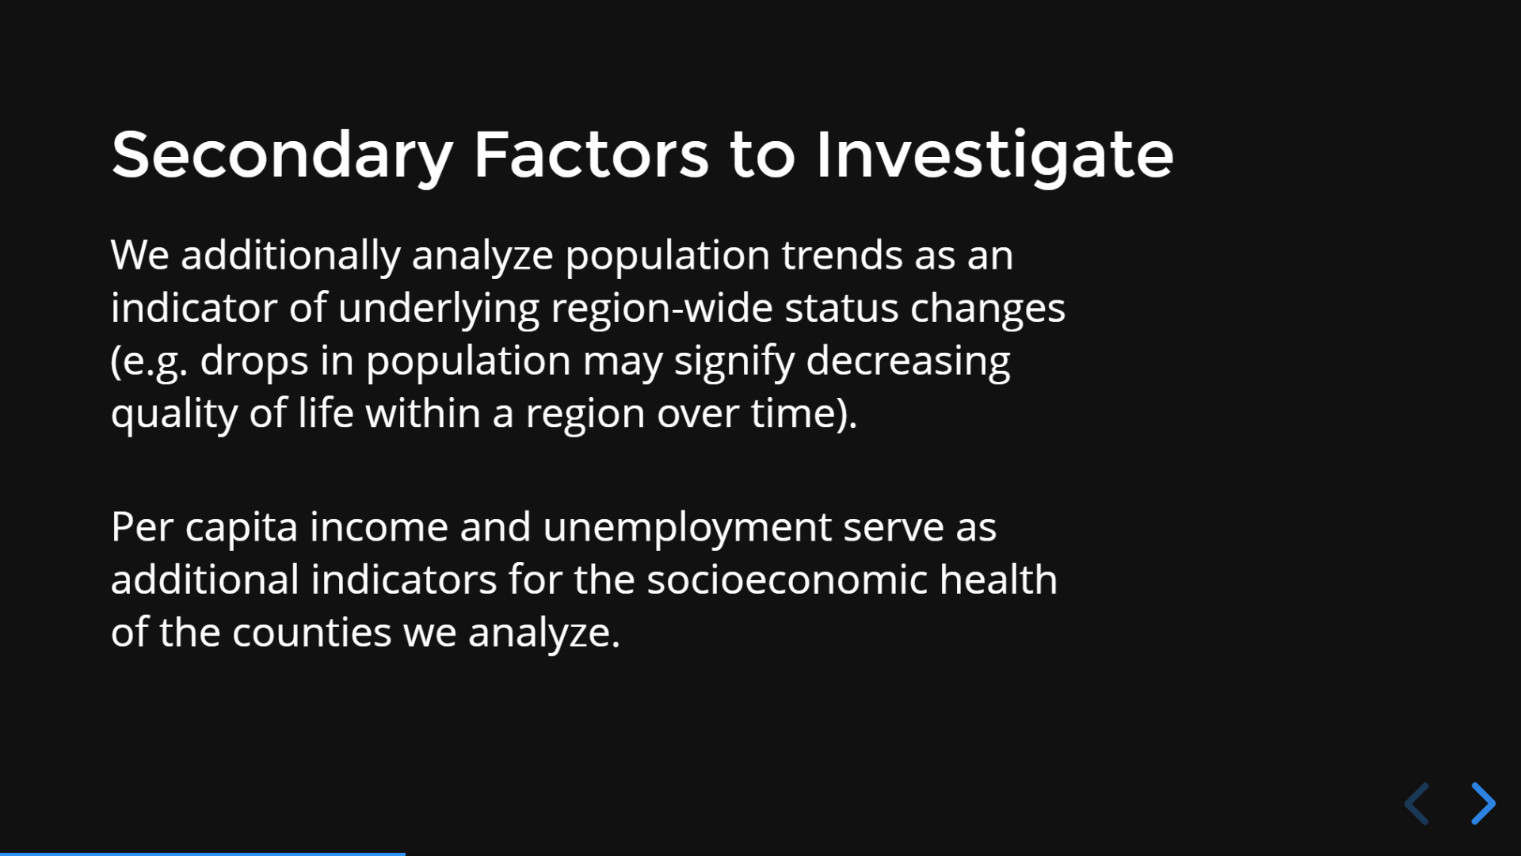
Notes:
Ty

Slide 10
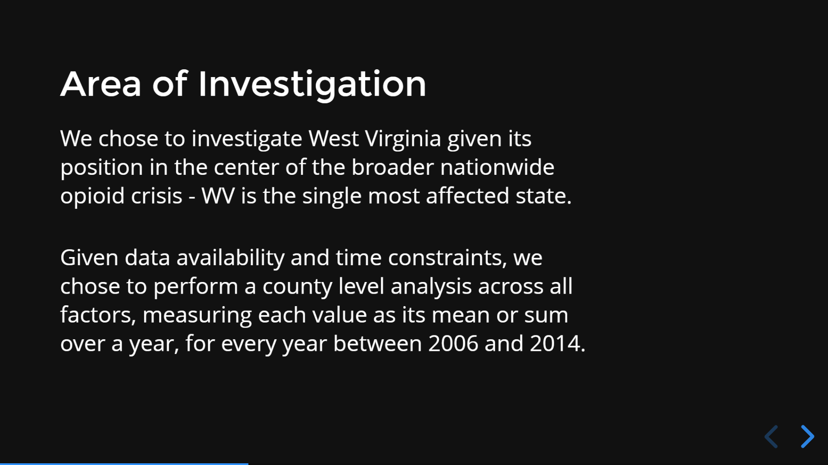
Notes:
Ty

Slide 11
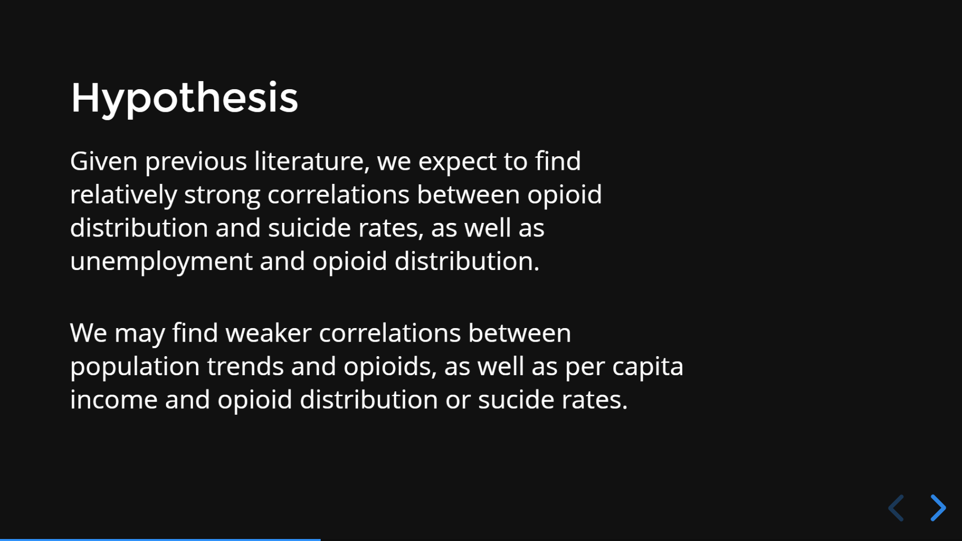
Notes:
Ty

Slide 12
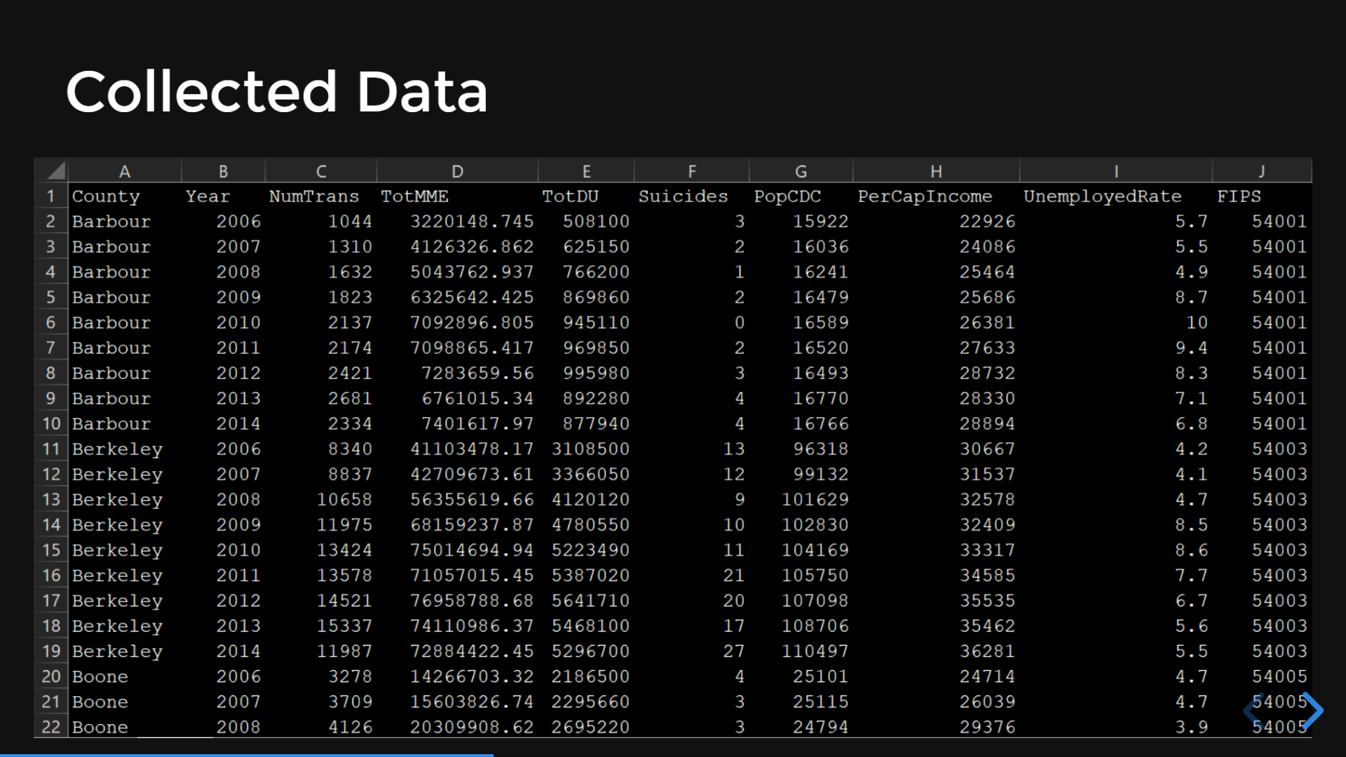
Notes:
In order to answer these questions and accept or reject our hypothesis, we first consolidated data from numerous sources. We compiled opioid transaction data (columns C, D, & E here) from the DEA ARCOS database published by the Washington Post, converting transaction-level data into a broader county-level year by year overview. We used the CDC WONDER database as a source of information on suicides and the populations of these counties each year, theoretically providing us with a proxy for measuring rates of mental health disorders. Finally, we collected per capita income information from the U.S. Bureau of Economic Analysis and unemployment rate data from the Bureau of Labor Statistics.

Slide 13

(interactive graphs & charts @ avirut.me/fortyfive)
Notes:
Our analysis and data visualizations, which are contained in the following slides, are better viewed and interacted with via the online version. In the online version, maps can be zoomed/moved around, counties can be hovered over for exact data, and graph data points can be hovered over for individual information.

Slide 14
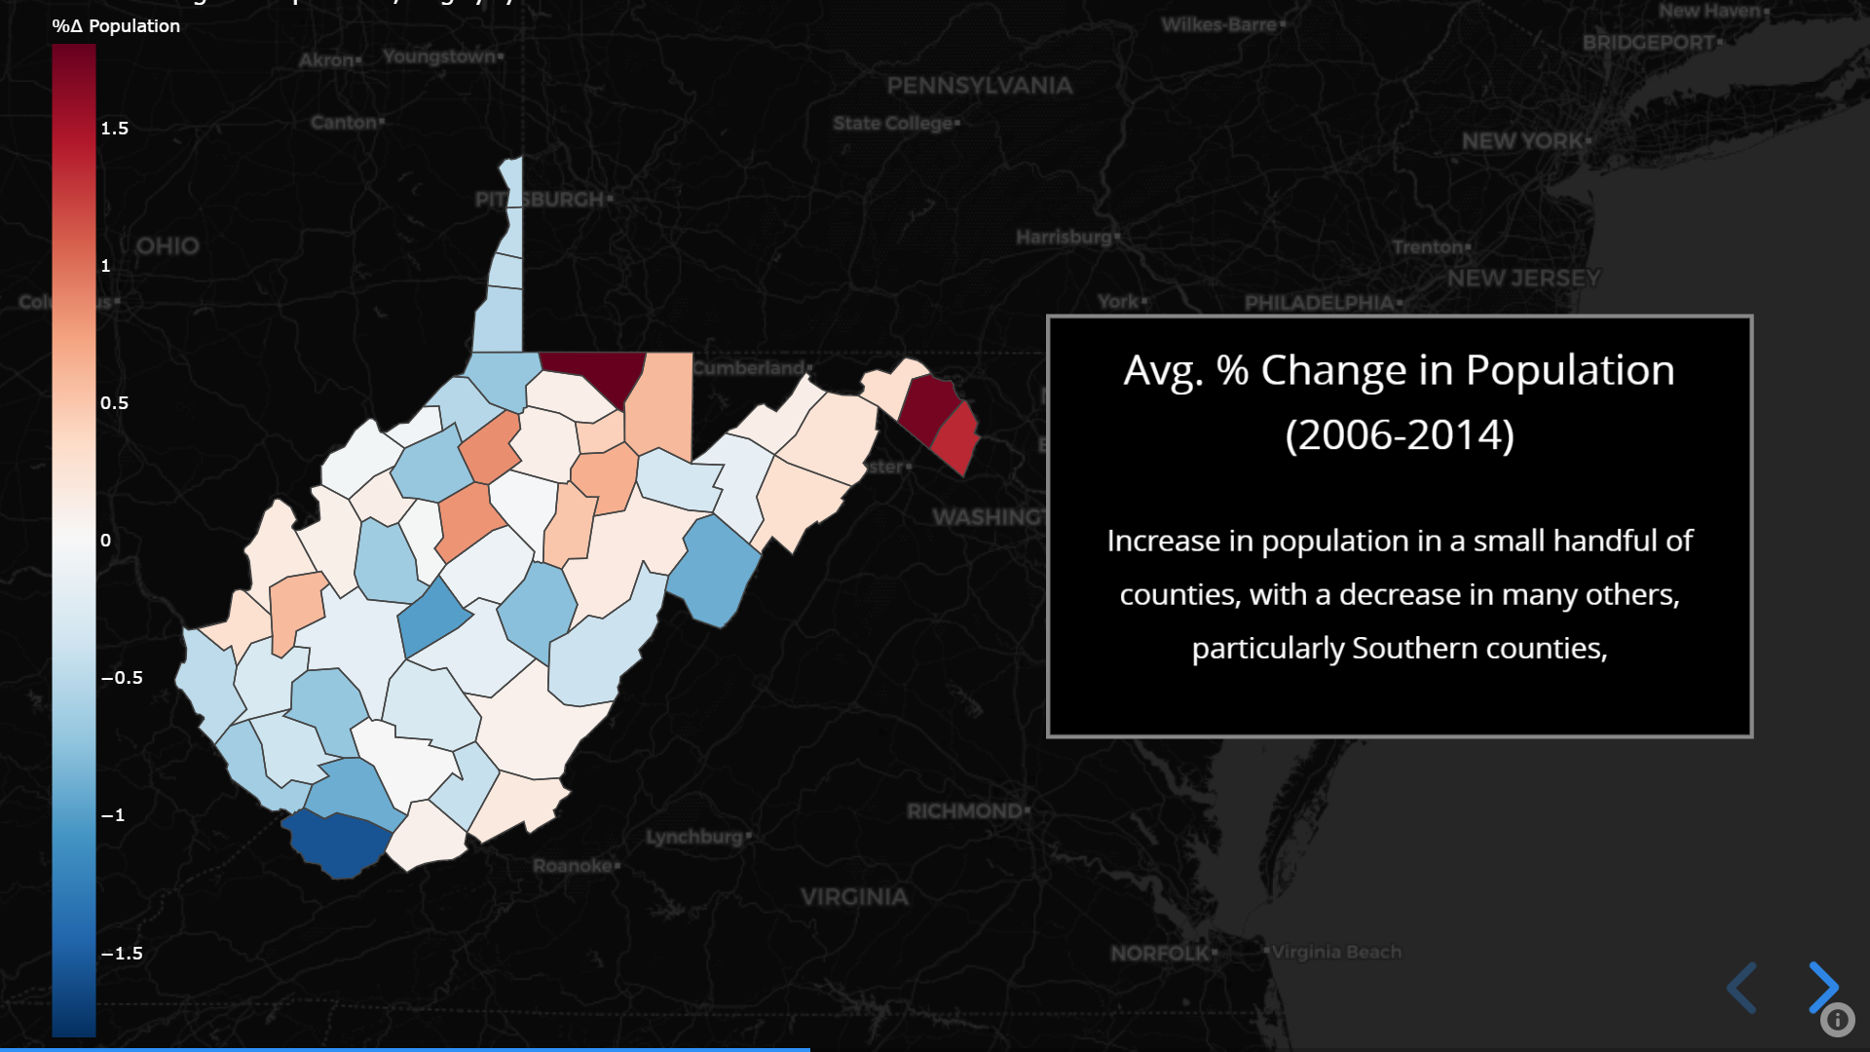
Notes:
First, we looked at general population trends by county to better understand how the state in general fared over this time period. We chose this as a potentially valuable analysis based on the idea that counties which are generally healthy and attractive will experience immigration, whereas counties that are most affected by the epidemic might experience an outflux of individuals moving out to escape worsened conditions. We found that for most counties, populations remained steady or dropped mildly each year over this time period. Some northern counties, however, experienced an increase in population. In our later analyses, we concluded that there was no correlation between this metric and changes of the intensity of the opioid crisis within a region.

Slide 15
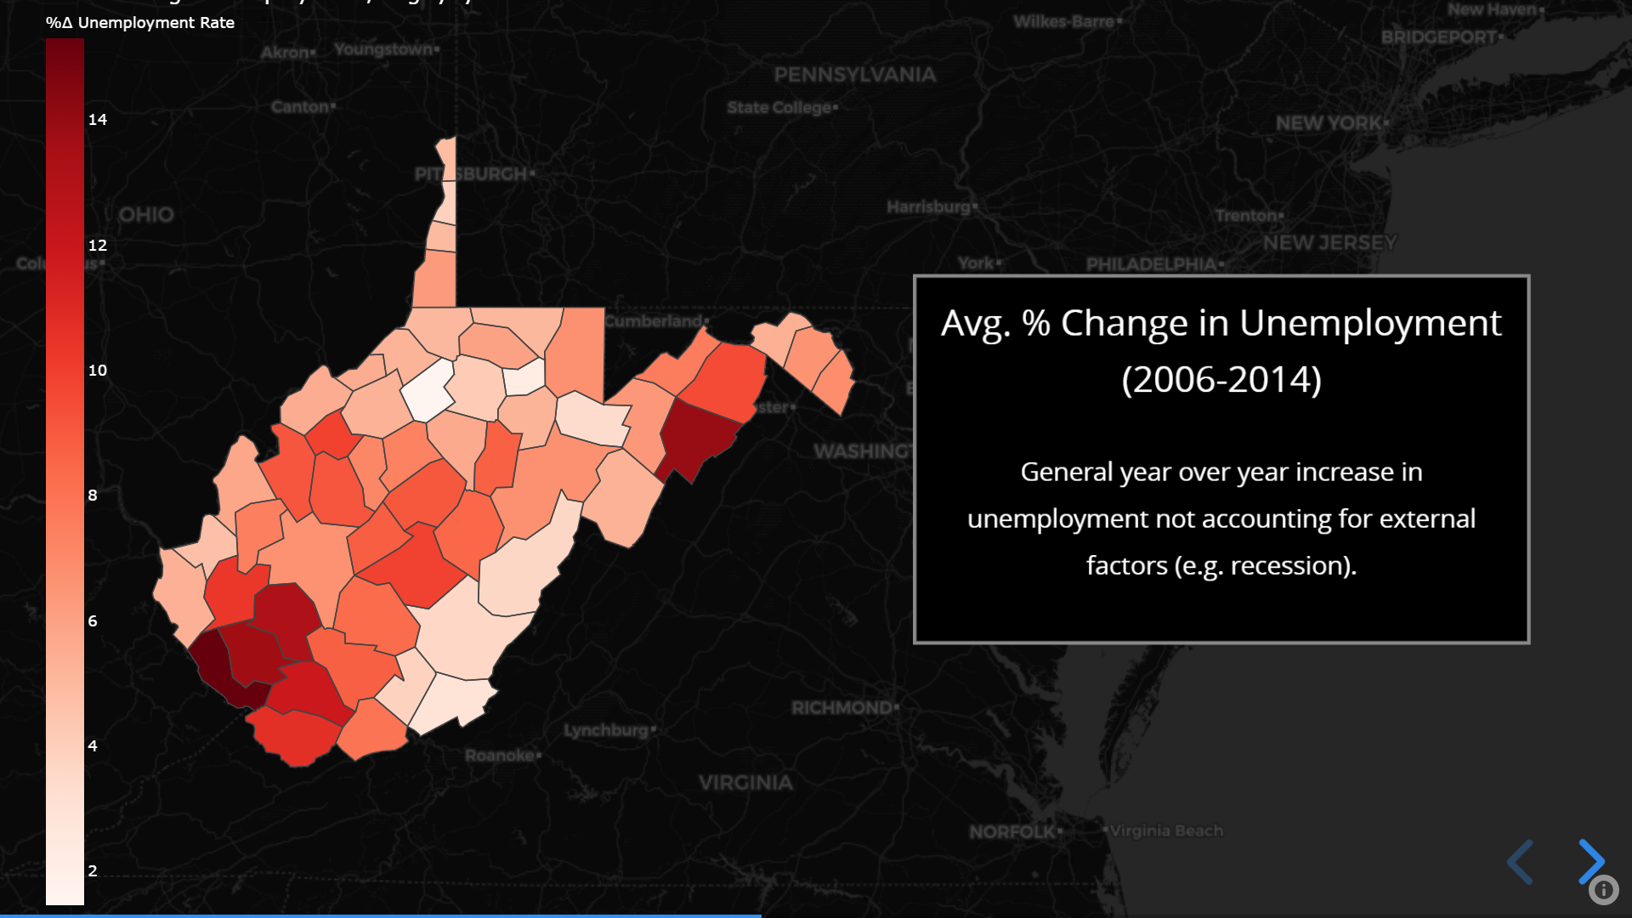
Notes:
We also evaluated trends in unemployment, based on the idea that counties which are most strongly affected by the opioid crisis would experience the greatest rise in unemployment. Our analysis, shown later, once again found this to be an untrue premise, and we observed no correlation between unemployment trends and the opioid crisis. We do note, however, that different counties experienced different unemployment rate trends over this period. This may owe to the various industries present in urban versus rural areas of West Virginia.

Slide 16
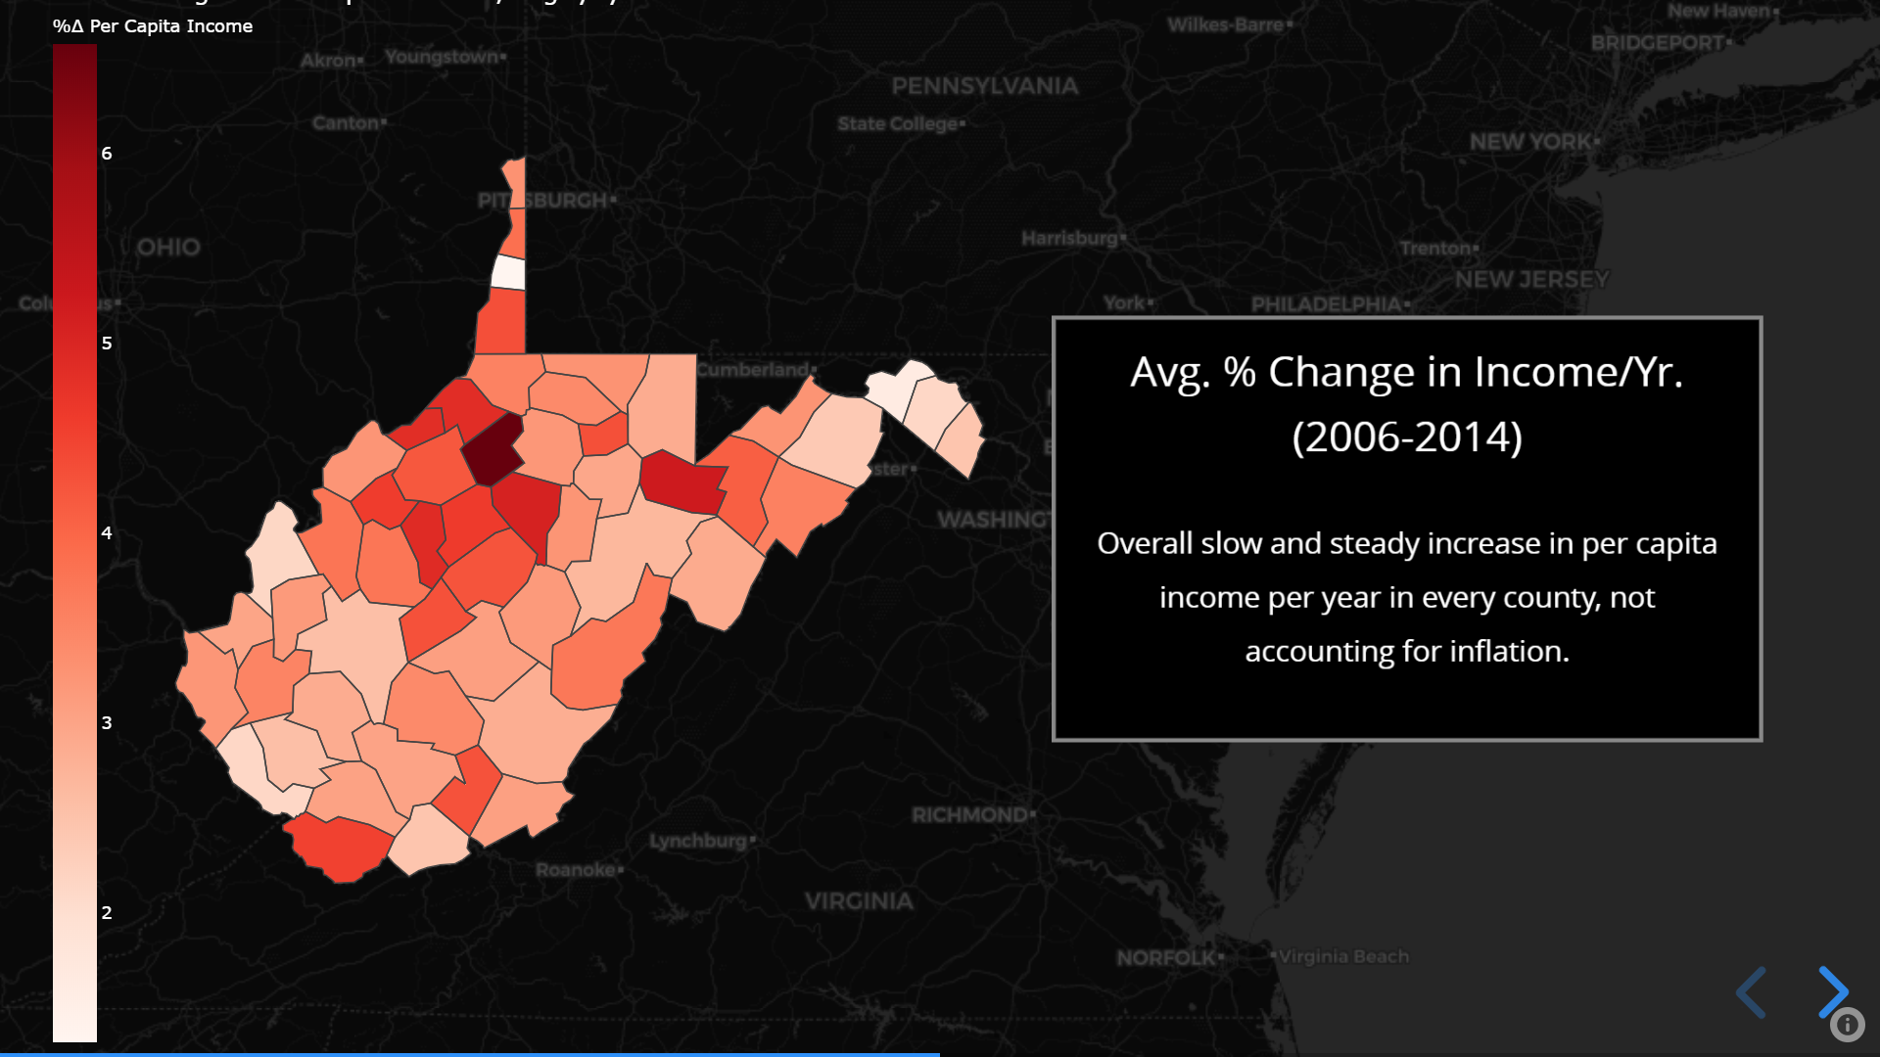
Notes:
We next looked at the average percent change in per capita income by each county from 2006-2014. Once again, we found no correlation between this metric and the opioid crisis, and once again we noted that some counties experienced much stronger increases in per capita income than did others. Largely due to the fact that our calculations of this metric don’t account for inflation, all counties here experienced at least some increase in income within this time period.

Slide 17
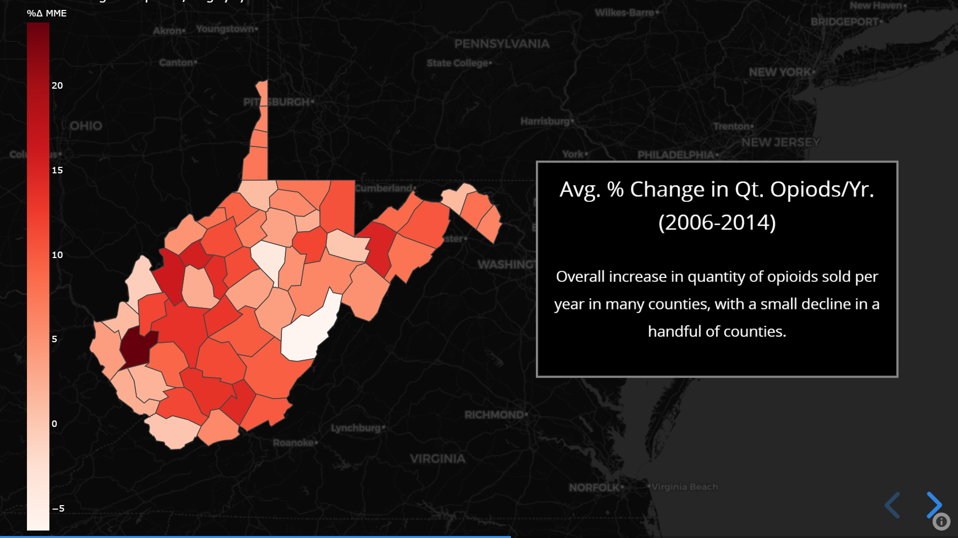
Notes:
We finally analyzed the two metrics that are at the core of our analysis: the opioid trade and suicide rates. Looking at the average percent change in the quantity of opioids distributed in a county year over year, we find that most counties experienced a strong growth in their opioid trade from 2006 to 2014. For example, a 20% year over year increase for 8 years – as is depicted here in a number of counties – would suggest a total increase of over 200%. To measure the quantity of opioids using our data from the ARCOS database, we looked at a measurement referred to as “milligram morphine equivalents”, which effectively means exactly what the name implies.

Slide 18
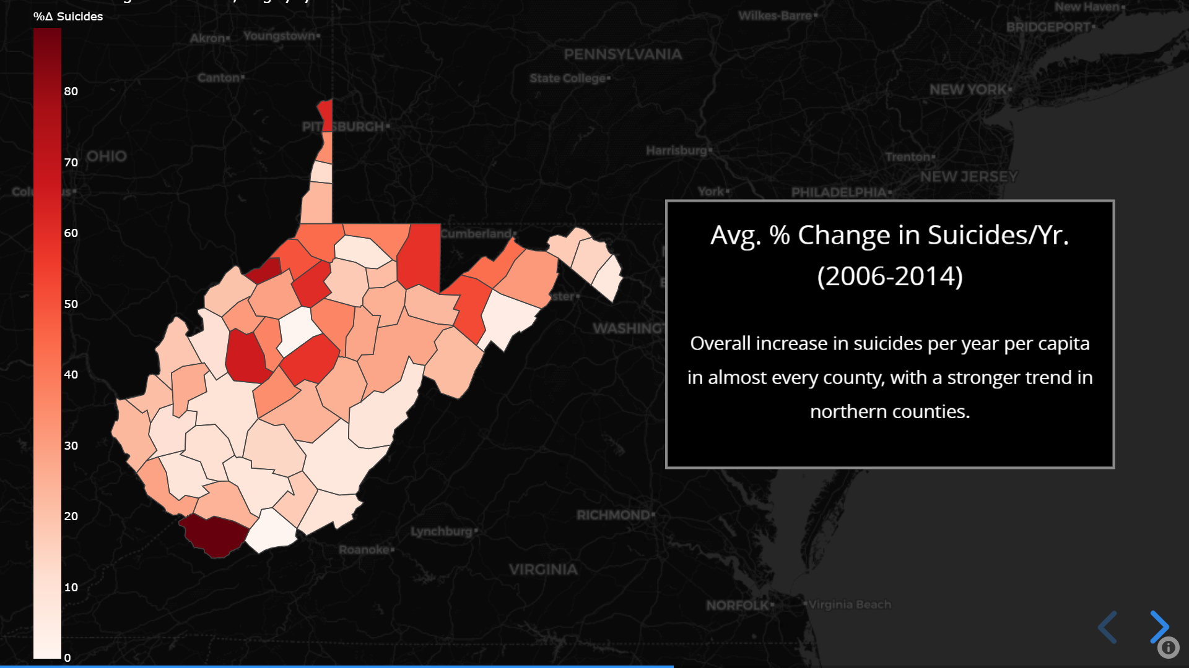
Notes:
Finally, we looked at the average change in the suicide rate year over year within this period. As is unfortunately the case throughout our analysis, we once again find no correlation between this metric and opioid transactions. One item of note, however, relates to McDowell County, seen here at the southernmost tip of West Virginia. Although there is no clear trend across counties, we absolutely noted that McDowell County both the strongest increase in suicides year over year and the largest decrease in population over this time period. Although it is impossible to draw supportable conclusions from this limited information, we note that there may be some correlation between mental health and population trends for a region to be further studied in the future.

Slide 19
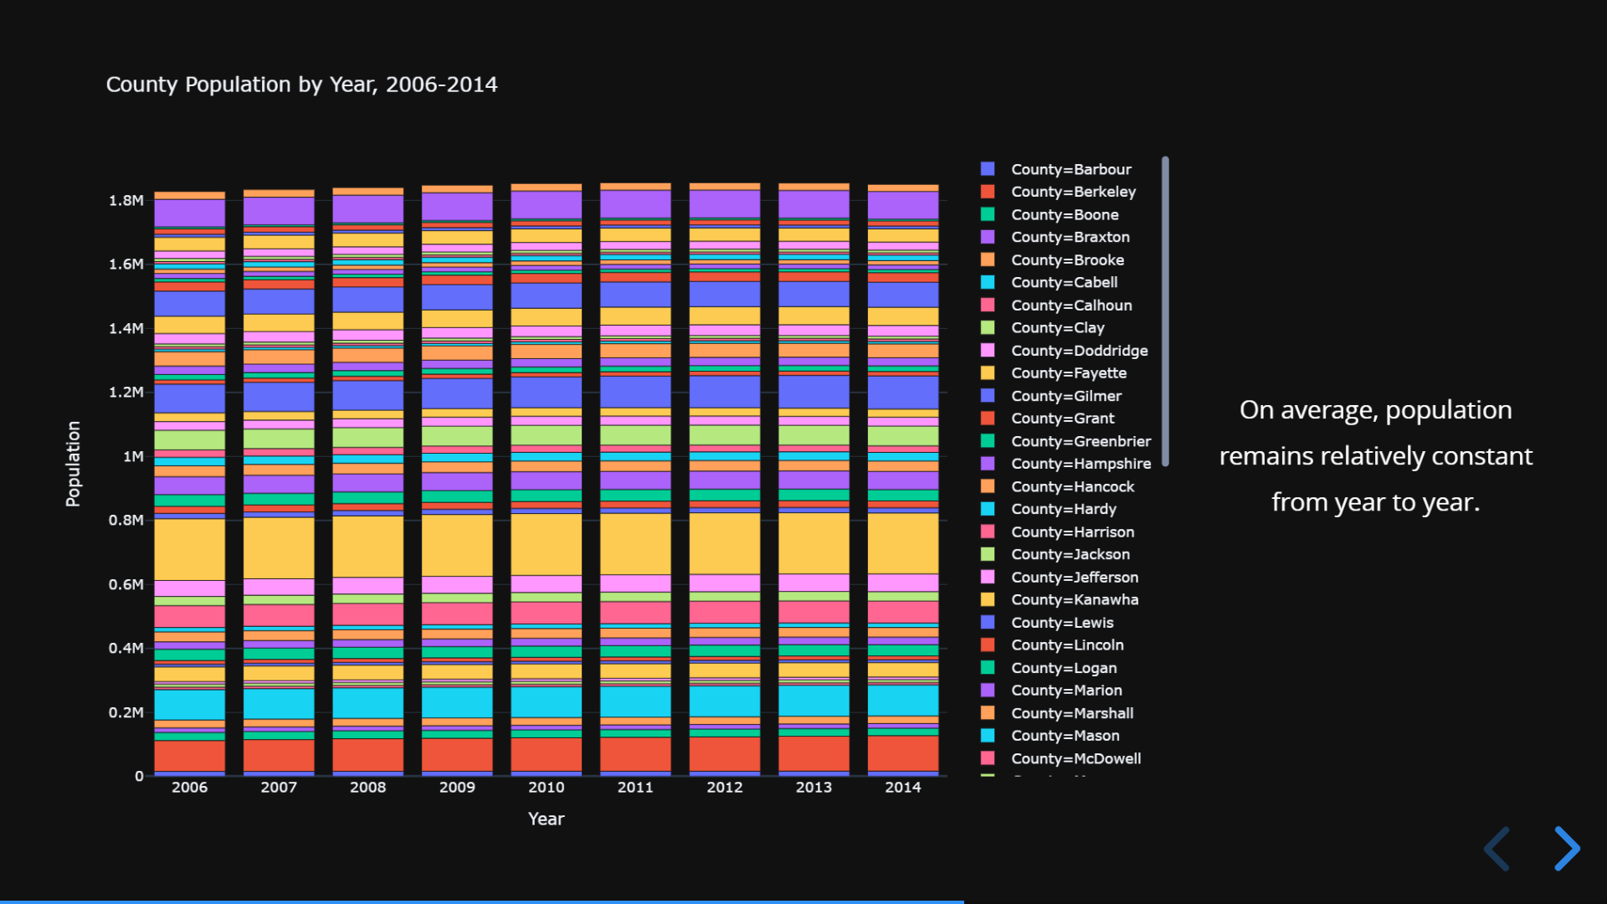
Notes:
Looking at county populations year by year, we note that the impacts of the percent change we noted earlier are negligible, and the population of the individual counties (as well as the population of the state as a whole) remains steady in general over the time period we looked at. While this bar chart demonstrates the general stability of the states’ population, the map we displayed previously demonstrated how population trends are county-dependent, with some counties growing their citizenry while others shrink.

Slide 20
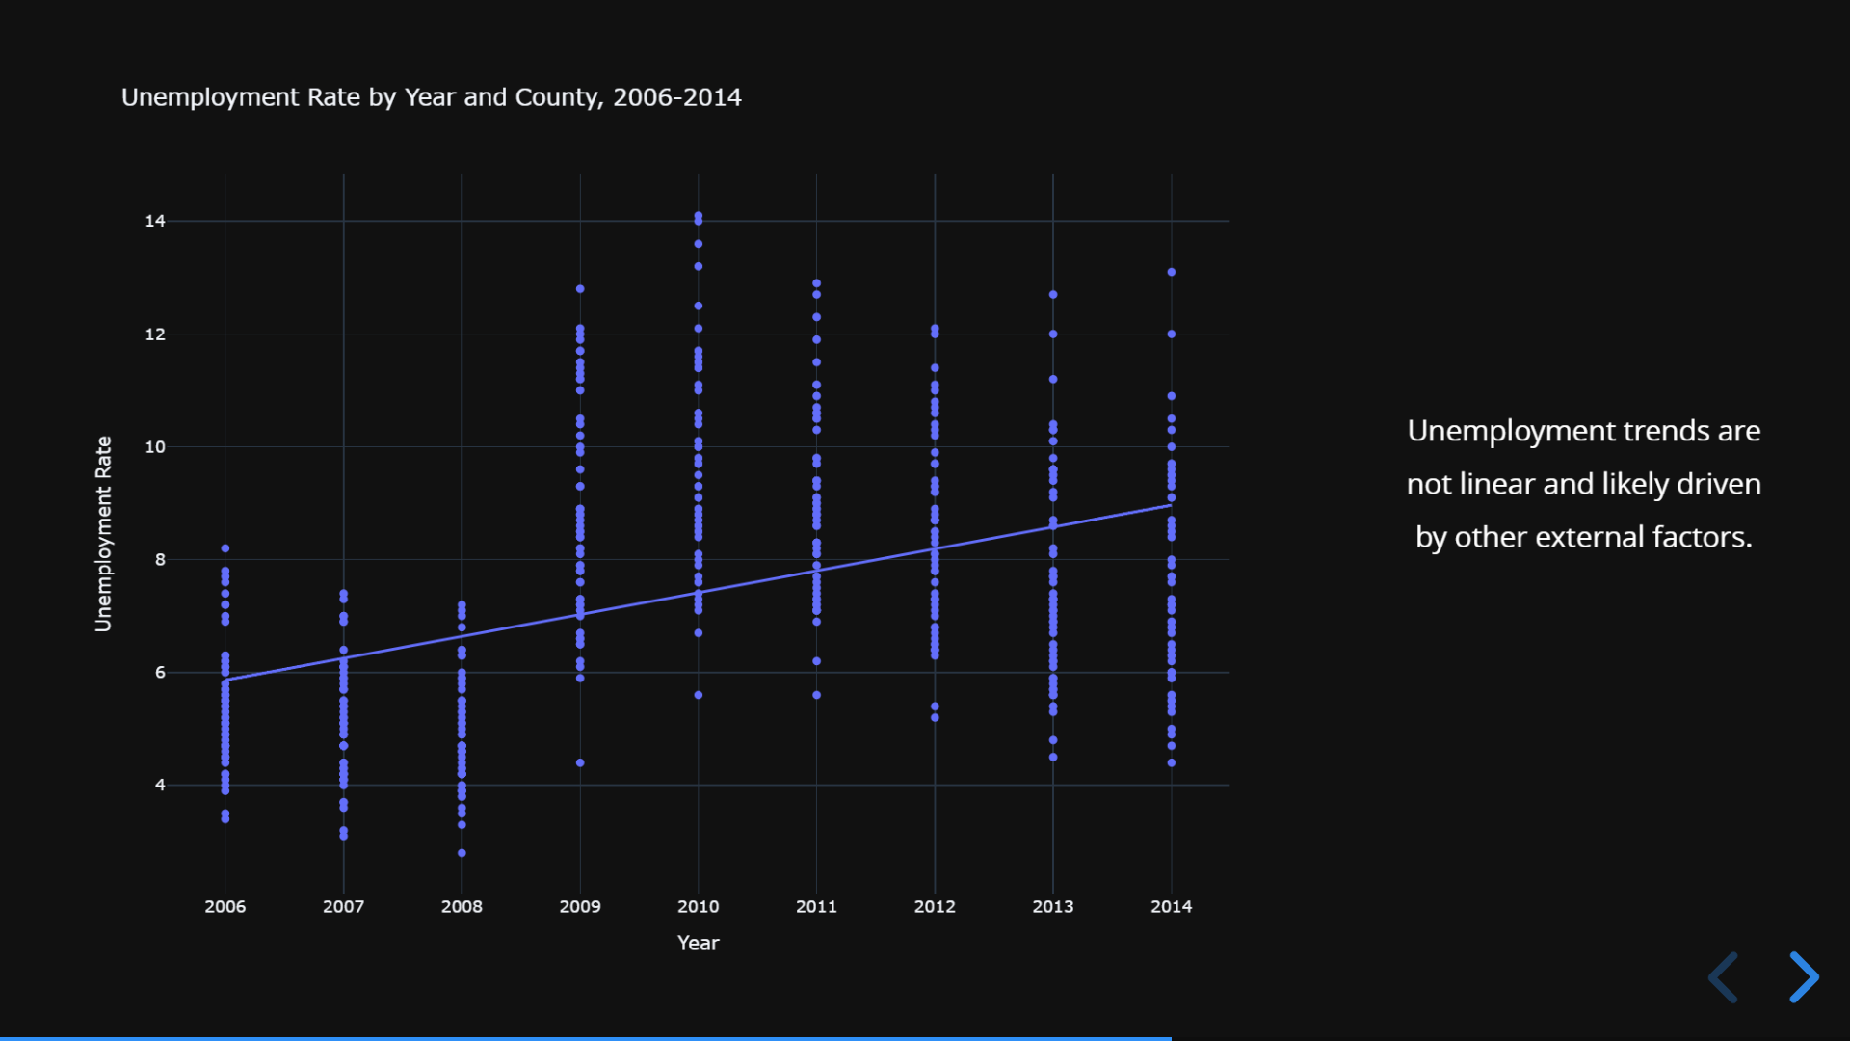
Notes:
The unemployment rate for the counties we sampled, from year to year, exhibited a non-linear trend. We attribute the rapid jump in unemployment between 2008 and 2009, along with the following steady decline, to the financial crisis/recession and recovery. The fact that external factors have such large impacts may help explain why we don’t observe any correlation between unemployment and the opioid crisis; although they may share underlying causes, these could be masked within unemployment trends by the broader scale shifts driven by economic conditions.

Slide 21
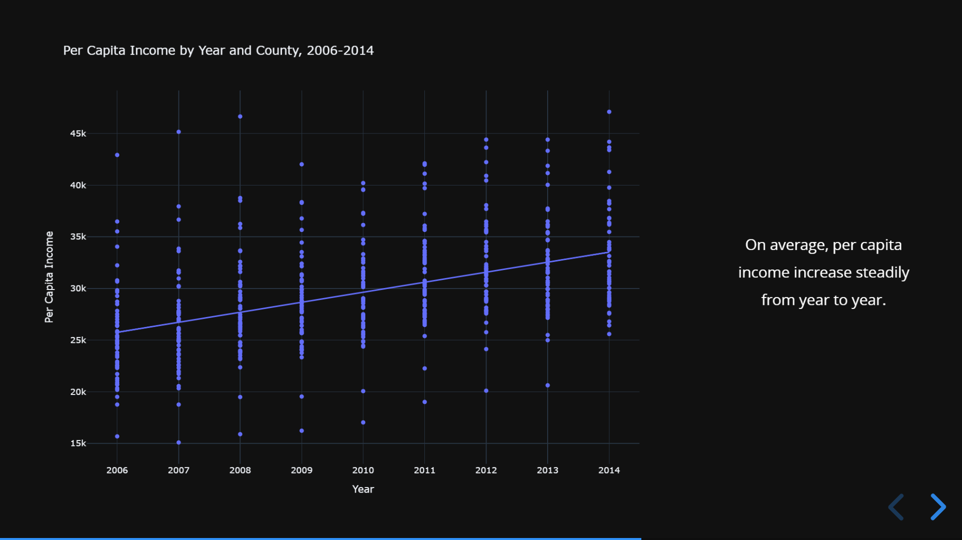
Notes:
Our data for per capita income fails to take inflation into account, and as such, we can see a slightly positive year over year increase in per capita income. Each dot here represents a county. One of the things we can observe from this, them, is the wide “inequality” of income distributions across counties. In the interactive web-based version, it’s possible to examine how a single county trends across years, and how certain counties seem to experience double or more the per capita incomes of others. Much of this has to do with factors like considering rural versus urban counties, but overall trends certainly indicate that per capita income is unlikely to have any link to the extent of the opioid crisis.

Slide 22
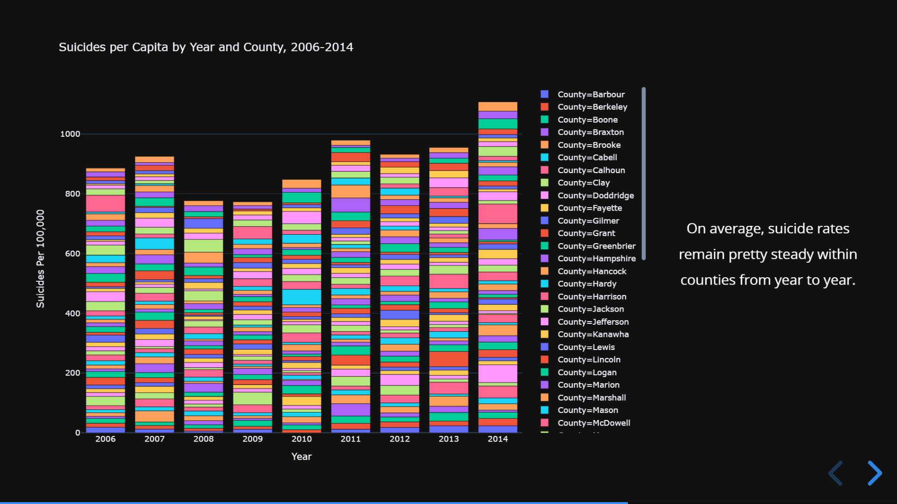
Notes:
We also observe that suicide rates change randomly over year to year, and are generally pretty steady on a large scale. The important factor we failed to consider when designing our “experiment”, and the downfall present in most of our analysis, is the fact that absolute numbers of suicides on a county-level scale in a single year are miniscule, and a small change in absolute numbers can therefore end up being a very large change percentage-wise. Some rural counties would even experience 0 suicides in a given year, and 3 in the next, a change that can’t easily be quantified as a percentage. As a result of these low absolute numbers and related shifts, suicide rates just aren’t a good measure of the average psychological health of a county, and demonstrate effectively no correlation with other factors, even when one might expect them to.

Slide 23
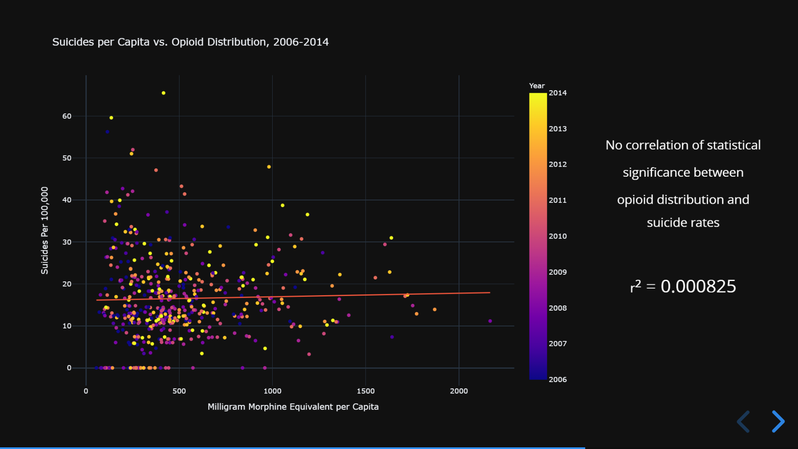
Notes:
Our first test in seeking correlations was a comparison of suicide rates versus opioid distribution. We performed this analysis in a number of ways – we looked at individual counties, at individual years, and at a combination of the two. In no scenario did we find any correlations, unfortunately. Ultimately, we show here all the data we collected – each point represents a single county in a single year, and once again, no correlation is present. The reality seems to be that due to the low absolute numbers of suicide rates, they simply are an ineffective measure for the general mental health of a county. This analysis could potentially be strengthened by adding together years in rolling groups (e.g. a running three year average of suicides to measure the rate), but we unfortunately did not have the time to perform such an analysis. We will look into doing so in the future.

Slide 24
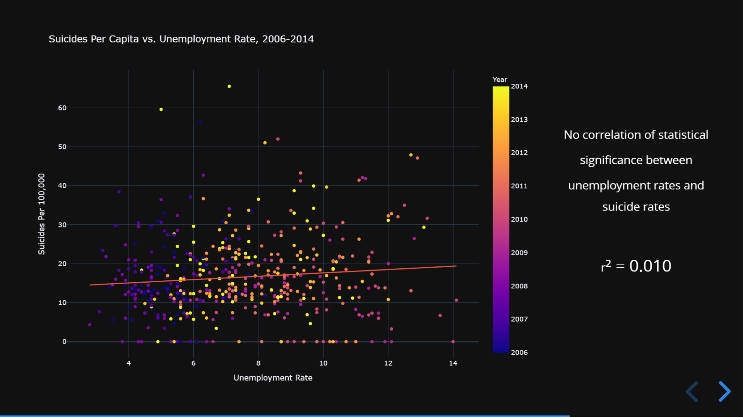
Notes:
Similarly, we observed no correlation between unemployment rates and suicide rates. Once again, we attribute this to issues with the metric of suicide rates in general. This analysis was also performed year by year and county by county, and no trends were visible in any of our groupings.

Slide 25
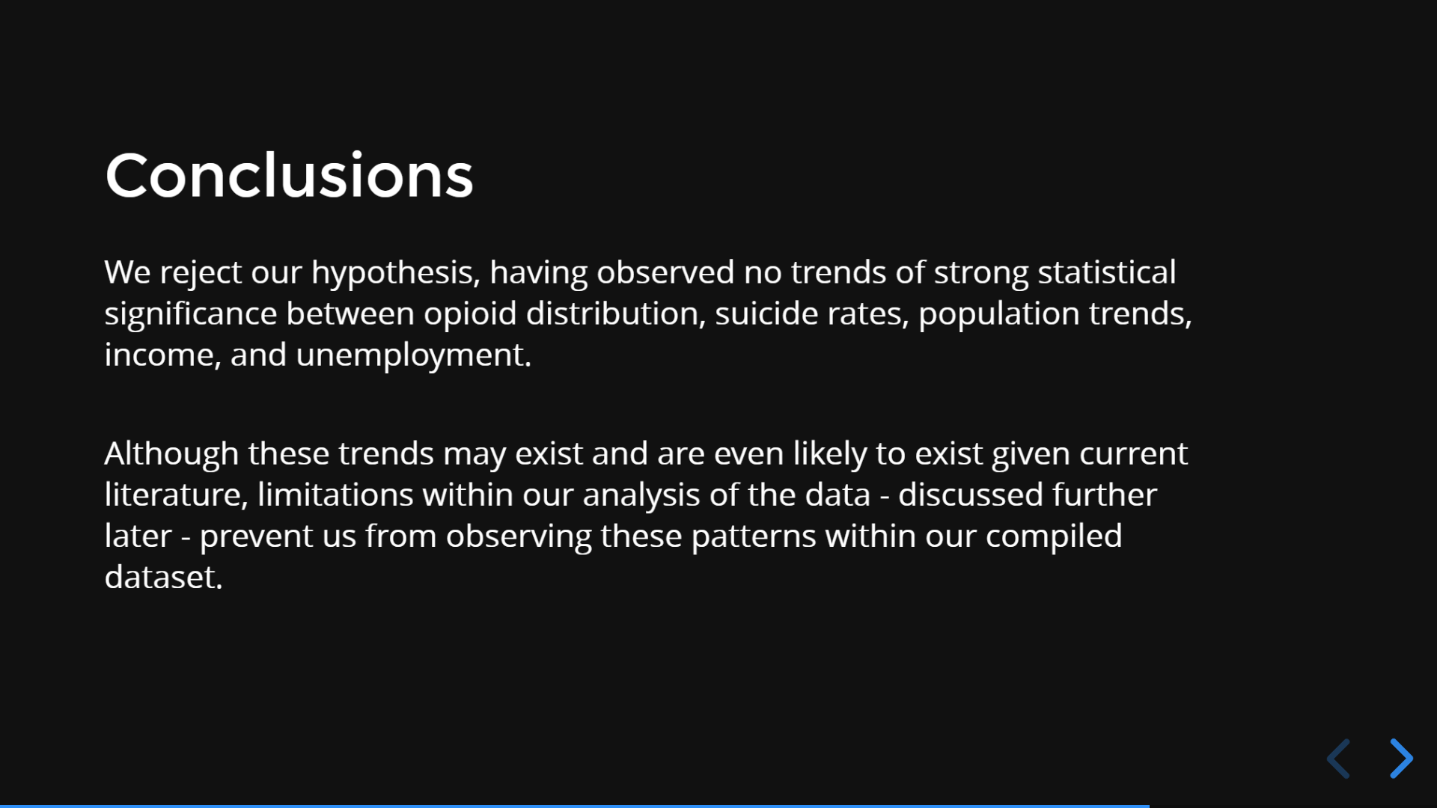
Notes:
Based on the data we’ve collected, we conclude that our hypothesis cannot be supported by any of our statistical analyses. Although the trends we predicted may really exist, it’s impossible to say whether or not they do based off of our data. The main underlying issue is the unreliability of the suicide rates metric in measuring the mental health of a county – we effectively assumed that this metric would be a proxy when it really doesn’t work well as one at all.

Slide 26
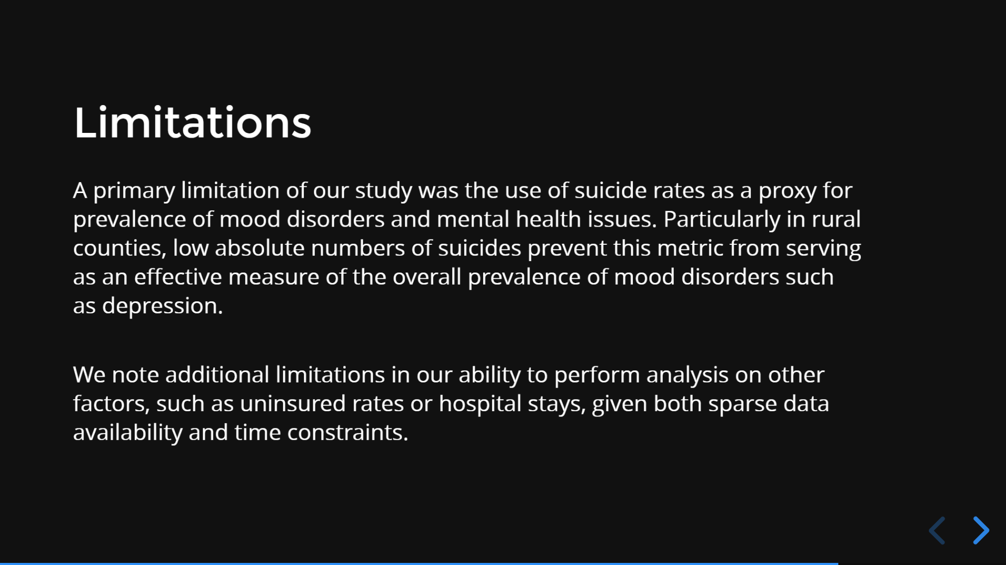
Notes:
As we’ve discussed, the use of suicide rates as a proxy for the prevalence of mood disorders was a misguided assumption because of low overall suicide rates in rural counties. We also note a time-based limitation (as well as data-availability based) in analyzing other potentially relevant factors. We might benefit from including the quantity of hospital stays or rates of insurance coverage at the county level to create a more robust analysis and seek other potential correlations which could then be targeted for interventions aimed at reducing the effects of the opioid crisis on mental health.

Slide 27

Notes:
If we were to extend our analysis in the future, we would focus mostly on seeking other measures of mental health disorder prevalence at the county level. Unfortunately, it simply seems that such data is not yet available, and we would therefore likely have to make attempts to collect such data firsthand. What might be more easy and more fruitful, then, would be to simply consider the data that we do have against other factors for which data is also available. We might look at graduation rates, utilization of healthcare, and the rates at which people are uninsured within a given county. Considering the aspects of these factors, we might also drop the time aspect of our analysis, instead averaging the data we have over the eight year period and then comparing these averaged values across counties to determine if any correlations or trends of interest are present.

Slide 28

Notes:
The vast majority of our analysis and data visualizations was completed in Python, using the numpy mathematical analysis library, the pandas data management library, and plotly.py for data visualization among other tools. We chose to use these tools as they allowed us to generate interactive figures which could then be published onto a website – hopefully, something more interesting than the traditional charts as images approach.

Slide 29

Notes:
Our data and source code can be accessed at the links listed above.

Slide 30
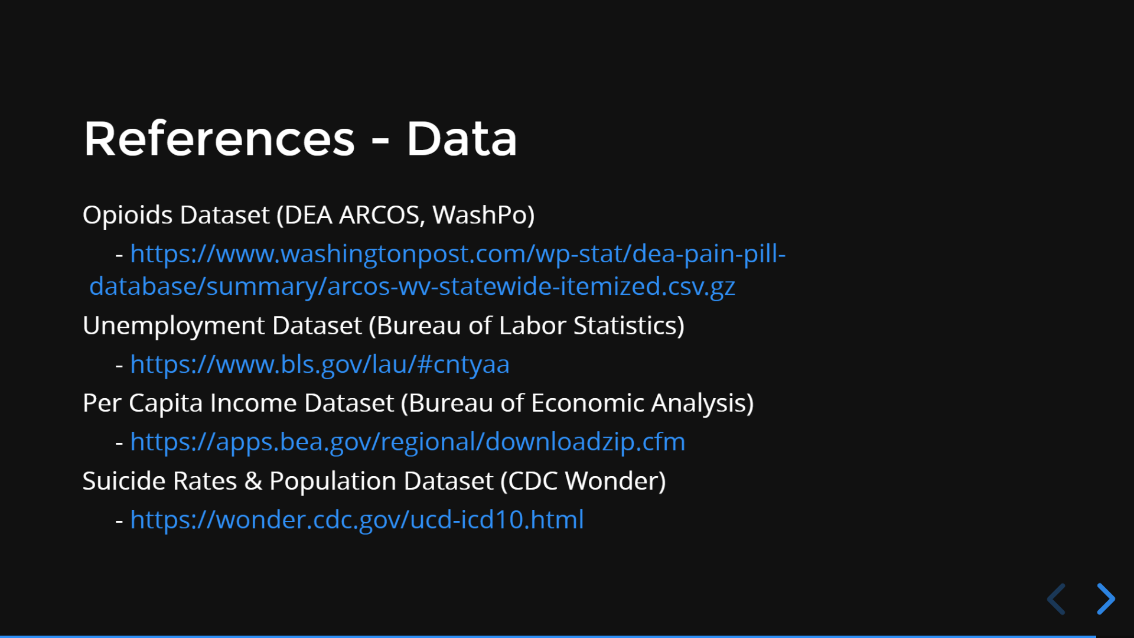
Notes:
These are the raw datasets we accessed in order to compile our analysis…

Slide 31

Notes:
…and these are the previous publications we referred to in attempting to understand what is already known about this issue and what conflicting information exists. Thank you!

Slide 32


